Slide 1
OS Introduction 2 Computer Organization
David Liu
SP 2022, Fall 2024

Slide 2
Learning Objectives
Discuss the role and importance of operating systems
Describe the general organization of a computer system and the role of interrupts
Describe the components in a modern, multiprocessor computer system
Illustrate the transition from user mode to kernel mode
Discuss how operating systems are used in various computing environments
Provide examples of free and open-source operating systems

Slide 3
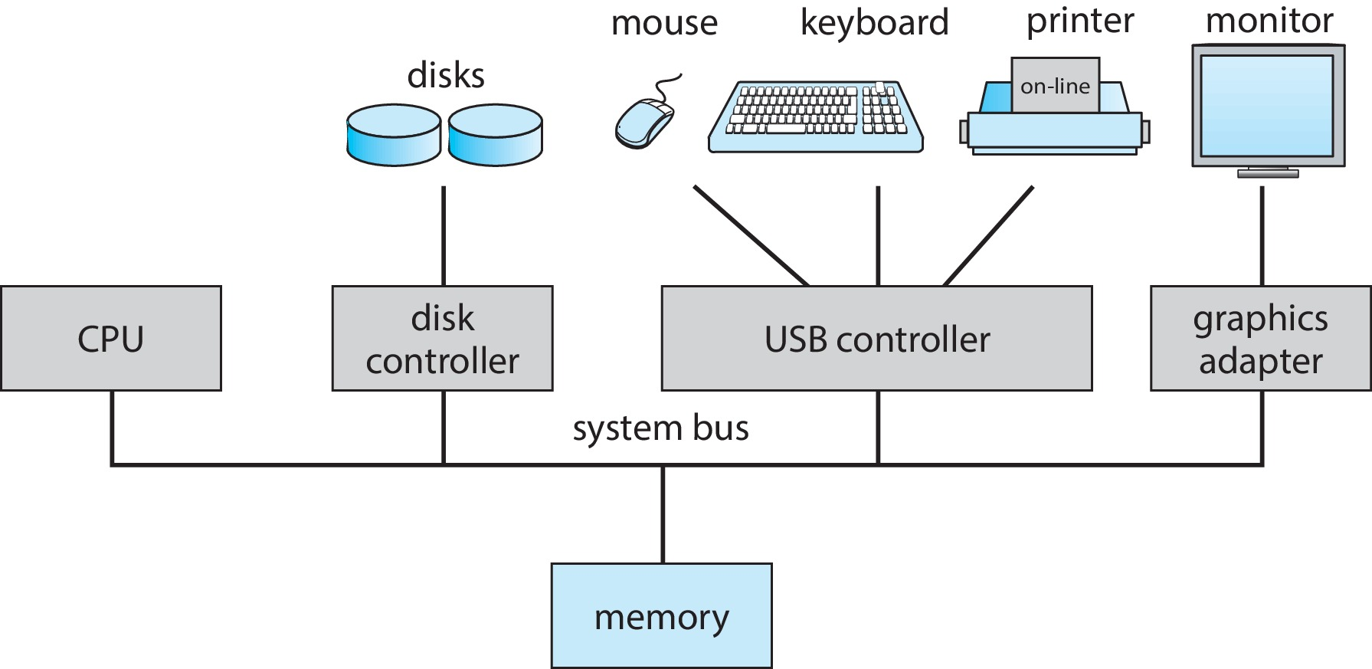
Computer System Organization
Common bus
CPU and devices compete concurrently for memory access

Slide 4
Computer System Operation
I/O devices and the CPU can execute concurrently
Each device controller is
in charge of a particular device type
has a local buffer
has an operating system device driver to manage each type
CPU moves data from/to main memory to/from local buffers
I/O is from the device to local buffer of controller
Device controller informs CPU that it has finished its operation by causing an interrupt

Slide 5
Interrupt Functions
Interrupt transfers control to the interrupt service routine (ISR) generally, through the interrupt vector:
the addresses of all the service routines
Interrupt architecture must
save the address of the interrupted instruction
save the process state information
A trap or exception is a software-generated interrupt caused either by an error or a user request
An operating system is interrupt driven

Slide 6
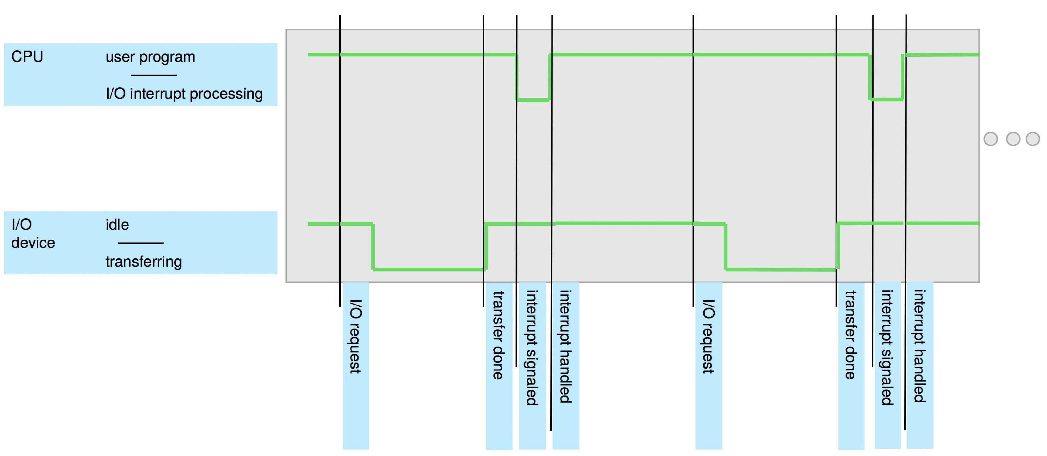
Interrupt Timeline

Slide 7
Interrupt-drive I/O Cycle
Interrupt request line
Interrupt number
Interrupt vector
Interrupt handler routing
Save and restore states
Resume interrupted task

Slide 8
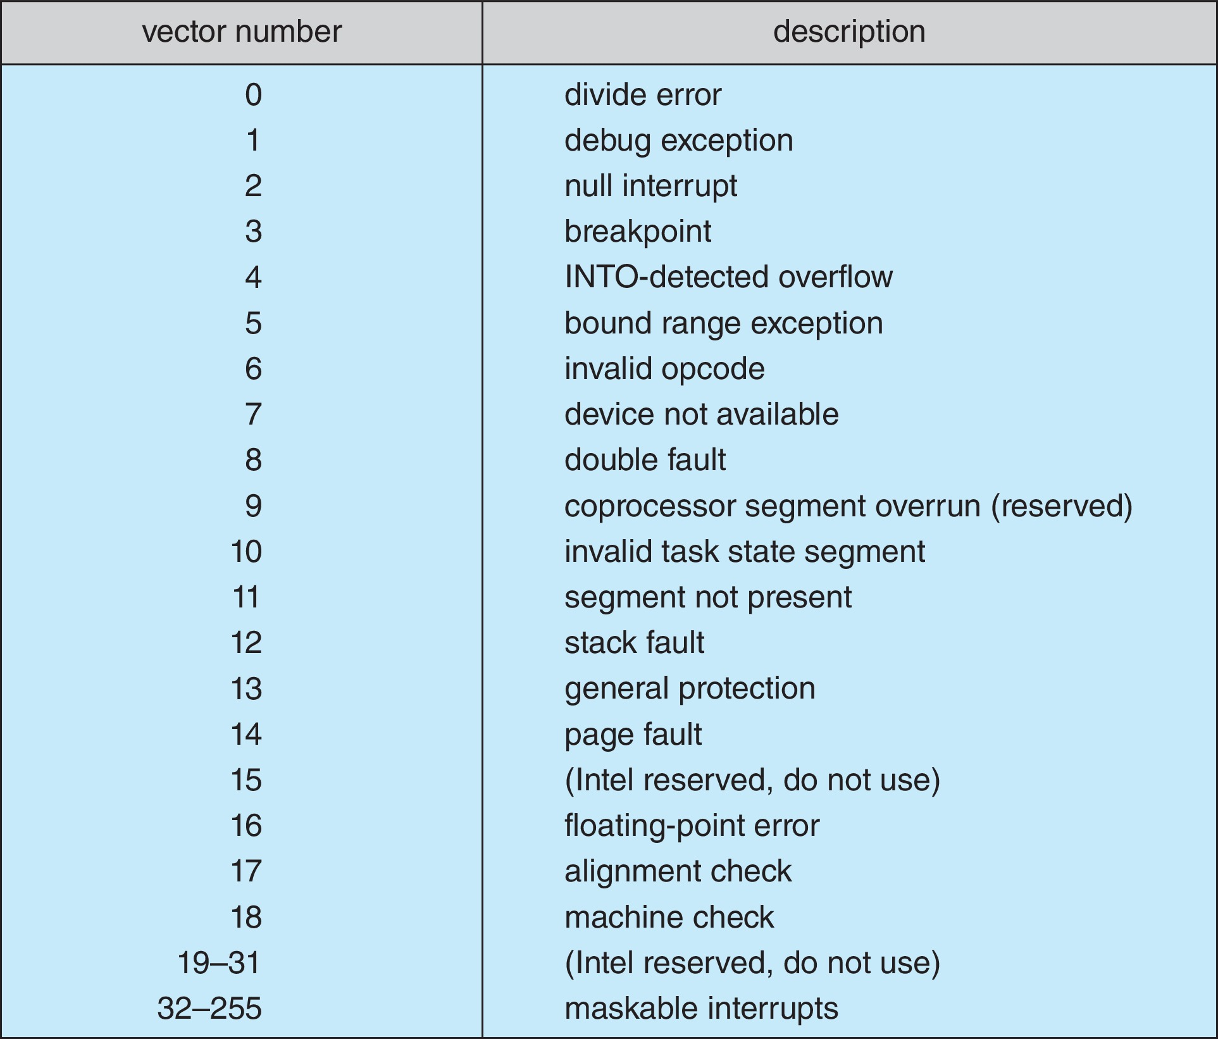
Interrupt Vector Table
No-maskable line
Maskable line
Interrupt priority levels

Slide 9
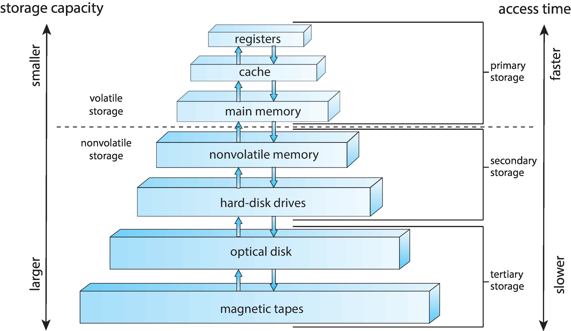
Storage Device Hierarchy

Slide 10
Storage Hierarchy
Storage systems organized in hierarchy
Speed
Cost
Volatility
Caching – copying information into faster storage system; main memory can be viewed as a cache for secondary storage

Slide 11
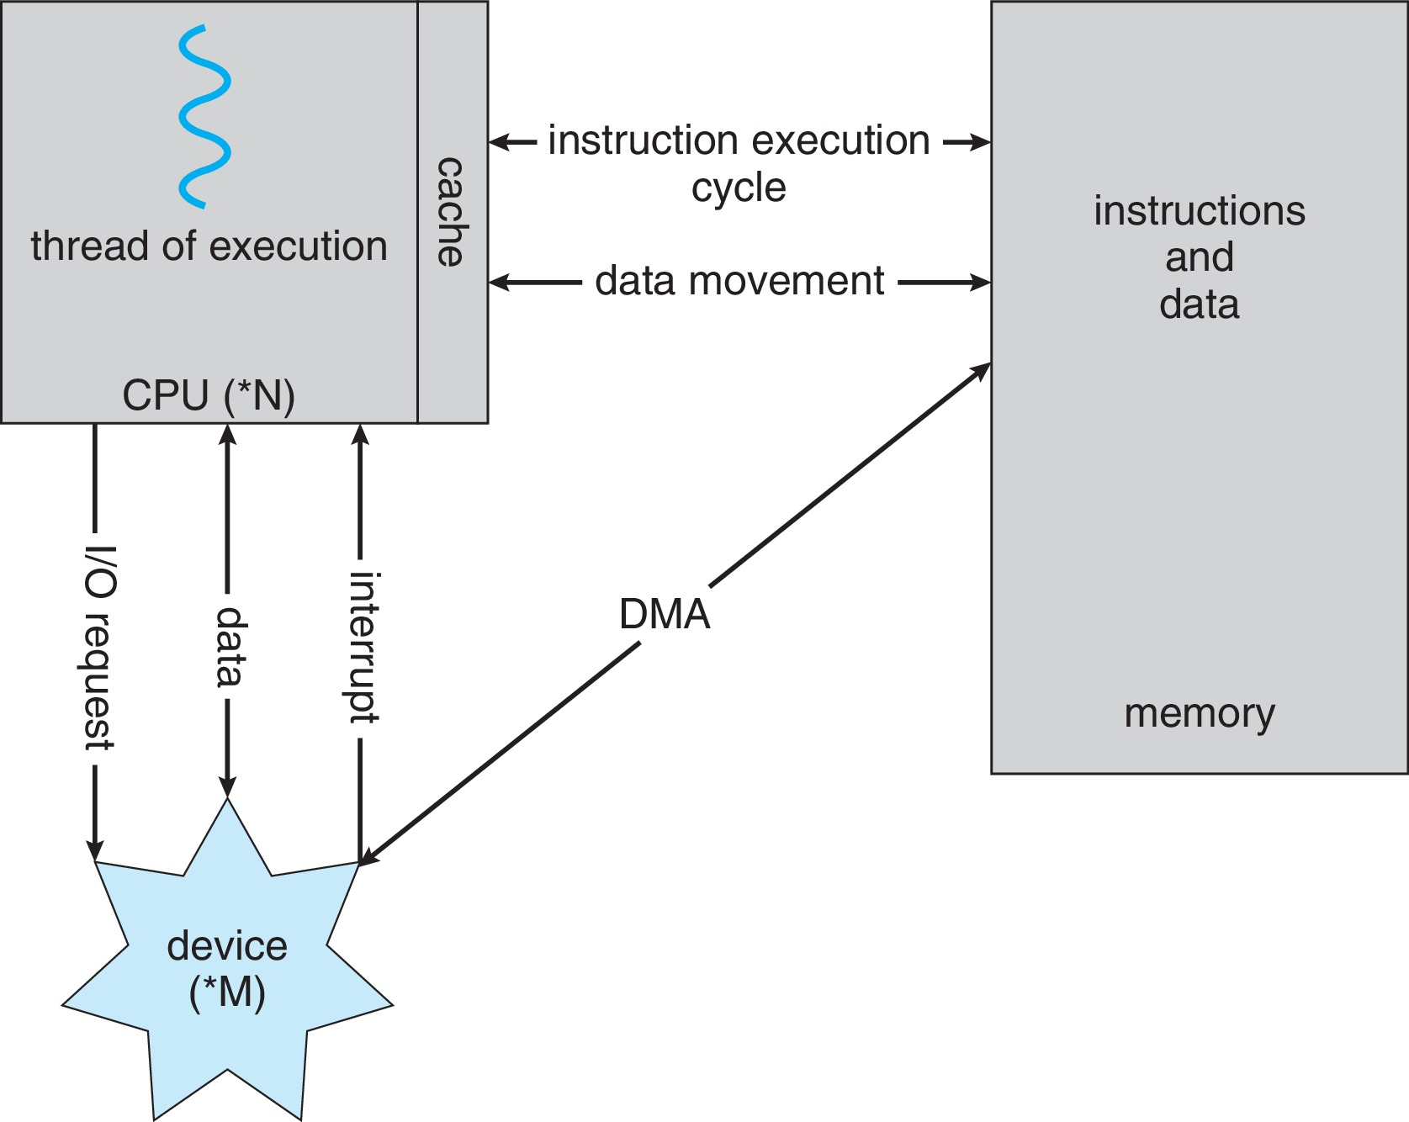
Von Neumann Architecture

Slide 12
Direct Memory Access
Only one interrupt per block, not per byte
Block directly between device and main memory

